Slide 1

Assignment Submission and
Result Management
Name – Christina Singh
Roll no – 12105053

Slide 2
INTRODUCTION
Result analyzer is basically an interaction between Admin And Student easily through web. This project describes how university result analyzer act or what function he provides to students . This project contain three categories namely ADMIN, STUDENTs through which students can easily interact with admin. Under admin these works are done

Slide 3
PURPOSE OF THE PROJECT:
The purpose of this project is to develop one Assignment Submission and Result Management for all Assignment and Result services. Improve student experience with ordering of Assignment and Result services. The main aim of this is to maintain the Assignment and Result system using web forms to reduce the paper and printing and distribution work. It also includes manage your Assignment Submission and Result Management, monitor your Assignment and Result, system. It provides a very friendly environment for both student and admin which improve efficiency of order processing.

Slide 4
Module Description
Well structured designs improve the maintainability of a system. A structured system is one that is developed from the top down and modular, that is, broken down into manageable components. In this project we modularized the system so that they have minimal effect on each other.
This application is designed into five independent modules which take care of different tasks efficiently.
Student Module
Admin Module.
Database Operations Module.
Add Module
Delete Module
Modify Module

Slide 5
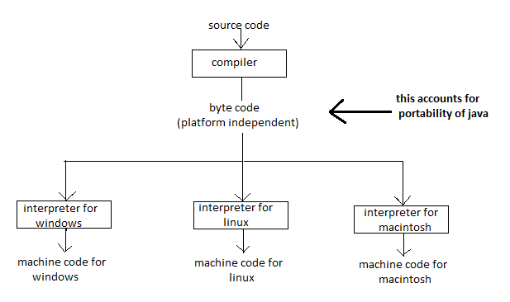
COMPILER/INTERPRETER COMBO
Here we list the basic features that make Java a powerful and popular programming language:
Platform Independent
Write-Once-Run-Anywhere.
Achieved because Java is both compiled and interpreted.
Compiler/Interpreter Combo
  Code is compiled to byte codes that are interpreted by a Java virtual machines (JVM).
  This provides portability to any machine for which a virtual machine has been written.
Java Integrates Power of Compiled Languages and Flexibility of Interpreted Languages.

Slide 6
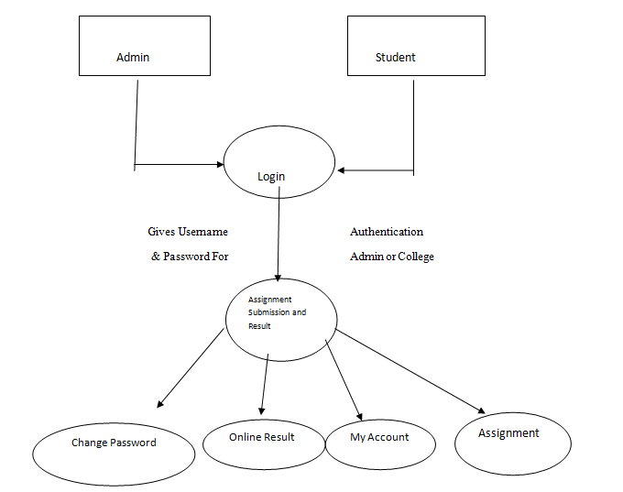
0 ‘ level DFD (Company Placement System)

Slide 7
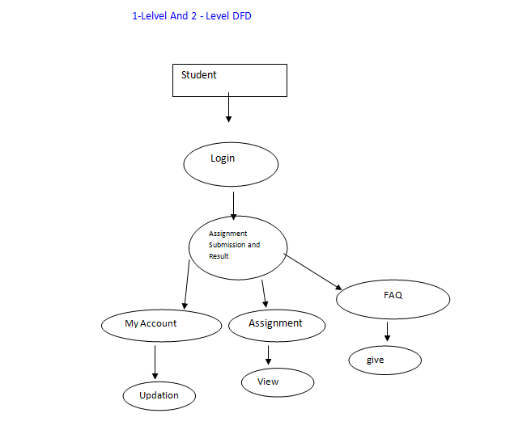

Slide 8
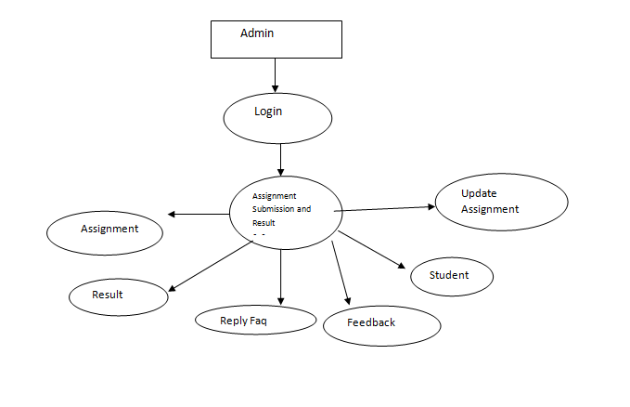

Slide 9
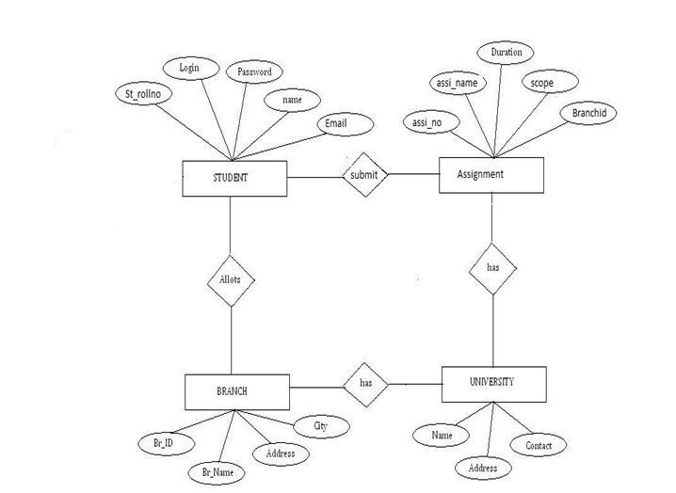
E-R DIAGRAM

Slide 10
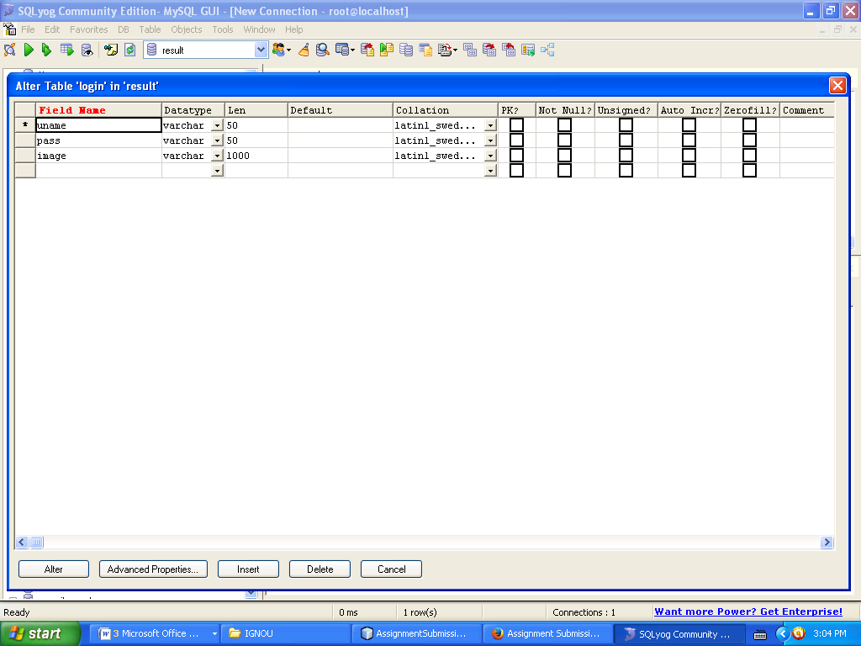
DATA BASE DESIGN OR TABLES

Slide 11


Slide 12
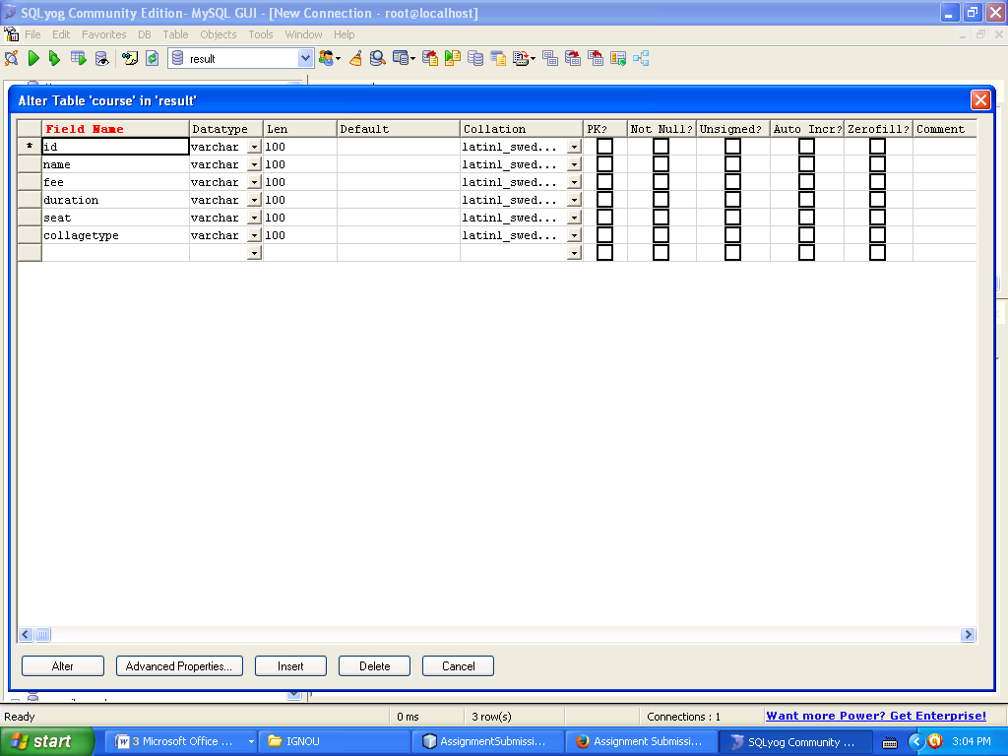

Slide 13

Screen Short

Slide 14
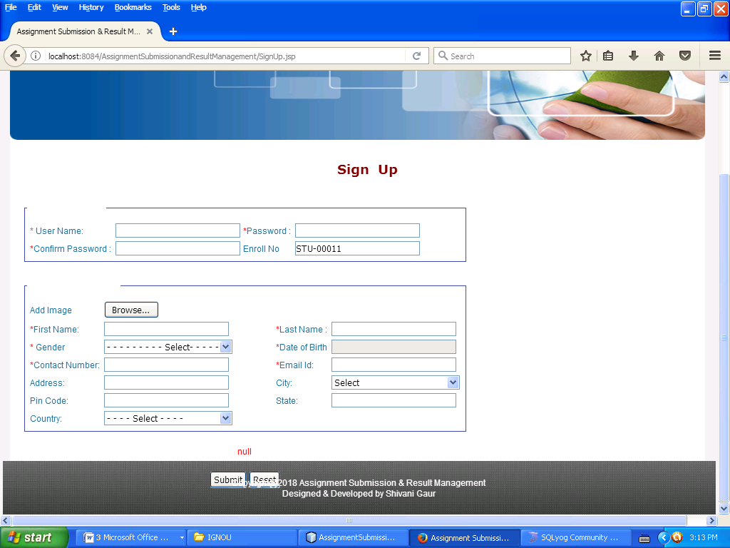

Slide 15
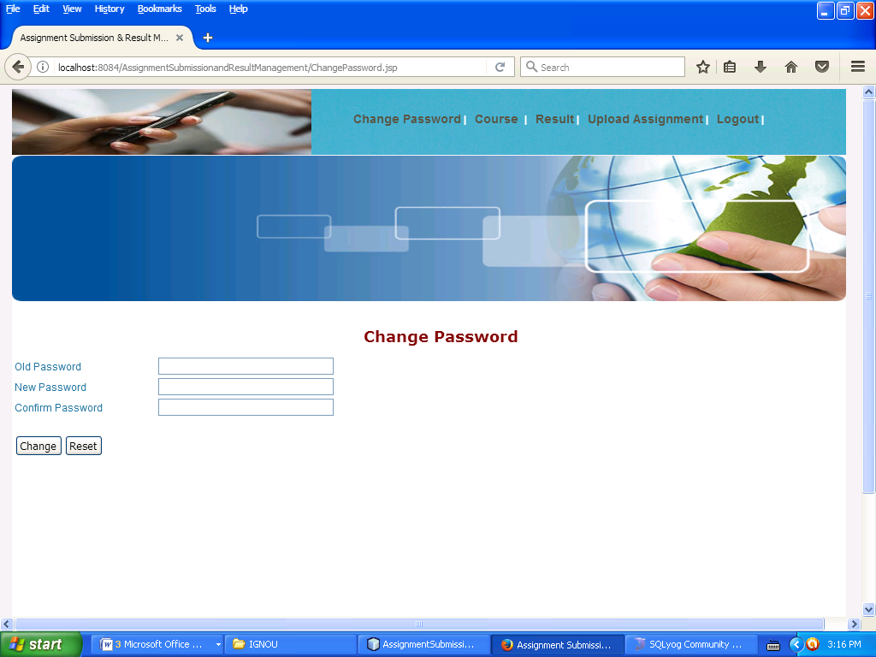

Slide 16
CONCLUSION
Employing the conventional method of marking college assignments is no longer adequate in this age, given the technological, informational, and electronic advancement in various fields of life. Hence, it is necessary to move from the erstwhile old systems to new electronic systems that are more effective. In this case, the possibility of marking assignments electronically becomes real and available.
The electronic marking of student assignments will save time, efforts and energy as well as expenses. It will also mean more accuracy and reliability for both the students and their instructors.
None the less, there are a number of considerations that ought to be taken into account, when dealing with this task:
This system had limited resources and time for development. This is why the researcher decided to summarize the conclusion and recommendations.

Slide 17


